Slide 1
From Developer to Domain Admin
Neacsu Costin-Alin

Slide 2
PS C:\> $env:USERNAME
-not Sysadmin
-not Developer
-not Pentester
PS C:\> $env:POSITION
Vulnerability Assessment Engineer at NTT Data Services, formerly Dell Services
PS C:\> $env:CONTACT
Twitter: @z00v4sh
Blog: https://zoovash.io
LinkedIn: https://www.linkedin.com/in/caneacsu/
Email: caneacsu@gmail.com

Slide 3
Agenda
What is PowerShell ?
Why use it ?
Windows Management Instrumentation (WMI)
Demo (post-exploitation scenario)
Initial compromise
Host Reconnaissance
Network Reconnaissance
Bypass UAC
Set Persistence
Create Evil Host Based Intrusion Prevention System (huh?!)
Create Schedule Task
Create Evil Domain Admin User
Got root ! Uhm ?!… no, got keys to the kingdom :)
Examples of PowerShell malware
Defenses

Slide 4
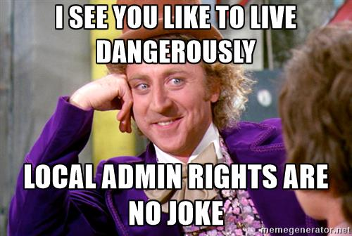

Slide 5
What is Powershell ?
Windows PowerShell is an interactive object-oriented command environment with scripting language features that utilizes small programs called cmdlets to simplify configuration, administration, and management of heterogeneous environments in both standalone and networked typologies by utilizing standards-based remoting protocols.
Actually, just a DLL
System.Management.Automation.dll
[psobject].Assembly.Location

Slide 6
Why Use it ?
By Default on Windows
Integration with all MS products
Built on .NET
COM (Component Object Model)
Registry
WMI (Windows Management Instrumentation)
Windows APIs
Can be extended
Trusted by AVs

Slide 7
PowerShell Version | Installed by default on | Can be Installed on
PowerShell 1.0 | - | Windows XP SP2 Windows Server 2003 Windows Vista Windows Server 2008
PowerShell 2.0 | Windows 7 Windows Server 2008 R2 | Windows XP SP3 Windows Server 2003 SP2 Windows Vista SP1
PowerShell 3.0 | Windows 8 Windows Server 2012 | Windows 7 SP1 Windows Server 2008 SP2 Windows Server 2008 R2 SP1
PowerShell 4.0 | Windows 8.1 Windows Server 2012 R2 | Windows 7 SP1 Windows Server 2008 R2 SP1 Windows Server 2012
PowerShell 5.0 | Windows 10 Windows Server 2016 | Windows 7 SP1 Windows 8.1 Windows Server 2008 R2 SP1 Windows Server 2012 Windows Server 2012 R2

Slide 8
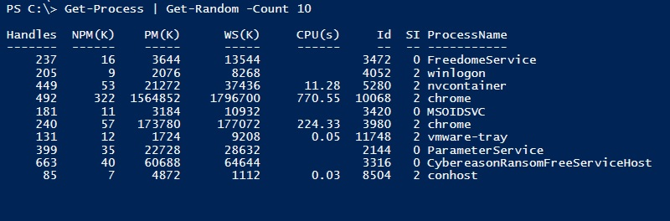
Commands follow Verb-Noun convention

Slide 9
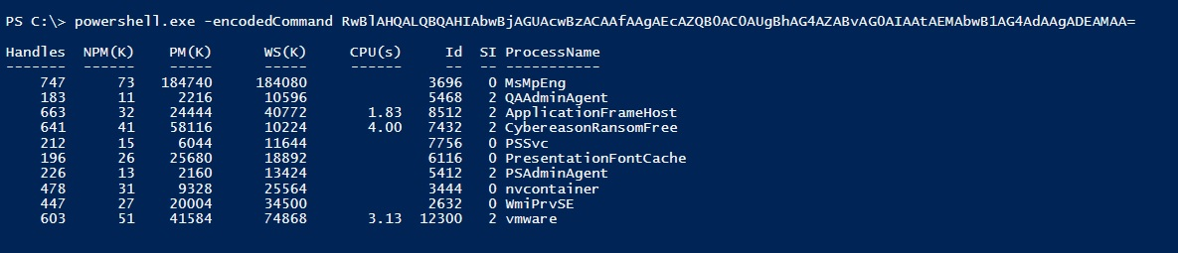
Powershell.exe -encodedCommand <base64>

Slide 10
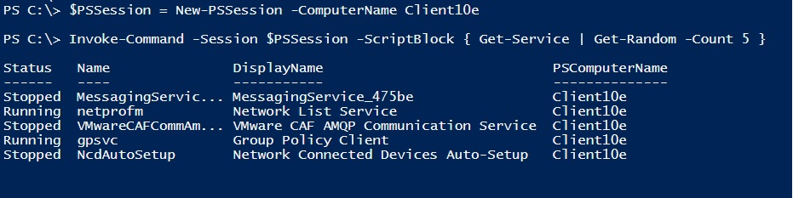
PSRemoting (similar to SSH but much more)

Slide 11
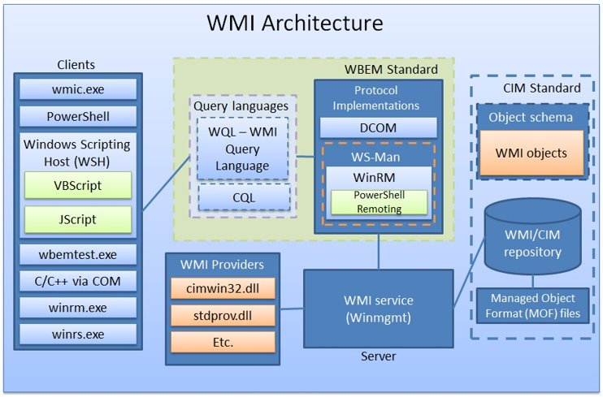
WMI (Windows Management Instrumentation)
Microsoft's implementation of Web-Based Enterprise Management (WBEM) and Common Information Model (CIM) industry standards published by the Distributed Management Task Force (DMTF)
Provides the interface for management data and operations for local or remote computers
Copyright: https://www.blackhat.com/docs/us-15/materials/us-15-Graeber-Abusing-Windows-Management-Instrumentation-WMI-To-Build-A-Persistent%20Asynchronous-And-Fileless-Backdoor-wp.pdf

Slide 12
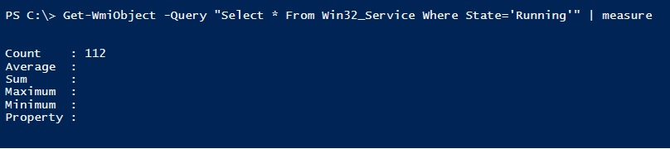
WQL

Slide 13
WMI Events
Special class that is instantiated every time the WMI/CIM repository is changed.

Slide 14
DEMO

Slide 15
PowerShell Malware
PowerWorm (2014)
http://blog.trendmicro.com/trendlabs-security-intelligence/word-and-excel-files-infected-using-windows-powershell/
Poweliks (2014)
https://www.carbonblack.com/2014/11/05/poweliks-malware-once-headline-worthy-is-simply-a-footnote-with-bit9-carbon-black/
PowerSniff (2016)
http://researchcenter.paloaltonetworks.com/2016/03/powersniff-malware-used-in-macro-based-attacks/
PowerWare (2016) - Ransomware
https://www.carbonblack.com/2016/03/25/threat-alert-powerware-new-ransomware-written-in-powershell-targets-organizations-via-microsoft-word/
POSHSPY - APT29 (2017) - Fileless WMI and PowerShell Backdoor
https://www.fireeye.com/blog/threat-research/2017/03/dissecting_one_ofap.html
Stuxnet (2010) - No PowerShell but uses WMI
http://poppopret.blogspot.ro/2011/09/playing-with-mof-files-on-windows-for.html

Slide 16
Defenses
PowerShell v5
Logging
Script
Module
Transcript
JEA (Just Enough Administration)
AMSI (AntiMalware Scan Interface)
Windows Defender and AVG (July 2016)
AppLocker / Device Guard – Whitelisting Solutions
Constrained Language Mode
No .NET, COM, Win32 API, C# in memory
Autoruns from Sysinternals (WMI specific)

Slide 17
THANK you !

